Slide 1
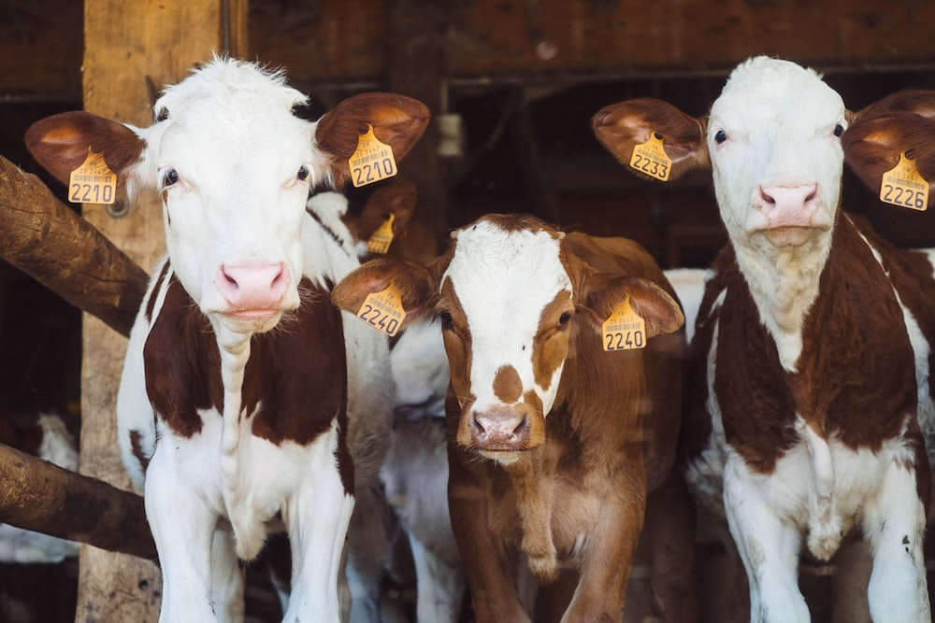
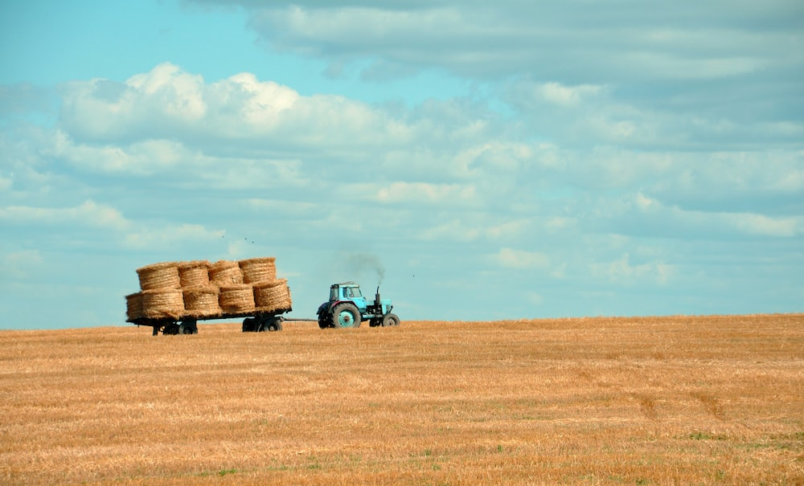
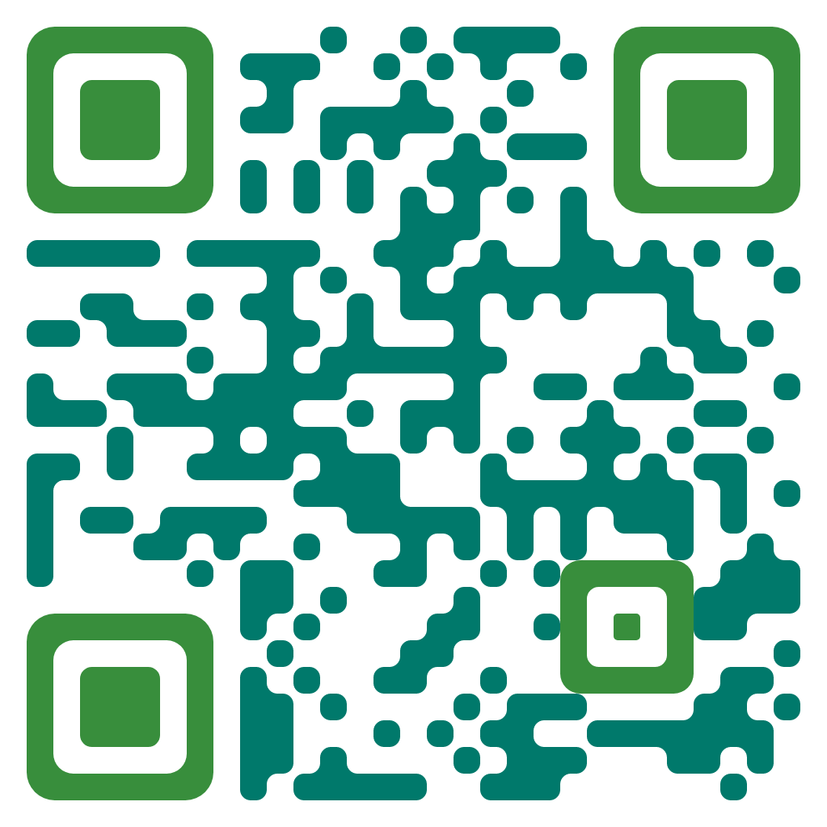
Environmental Sustainability Farm Strategy
(ES) Data and Systems Boundaries Group
WEBSITE
https://harper-es-data.github.io/website
Progress and
Projects Update

Slide 2
Project: Users of Farm Data Survey outcomes (complete)
Project: The Harper Farm Database (ongoing)
Project: Harper Farm crop system model (ongoing)
Outreach : Rothamsted Research North Wyke - HAU Future Farm Workshop

Slide 3
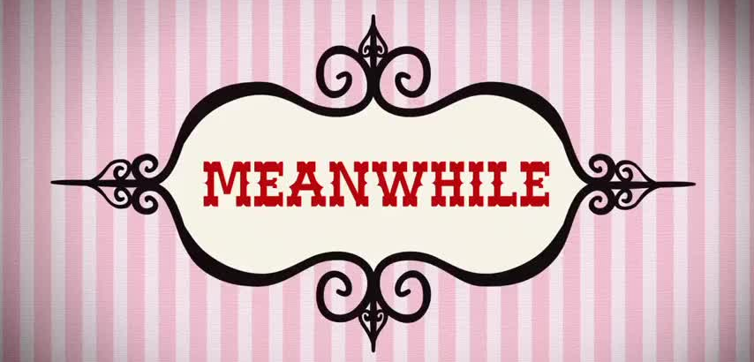

Slide 4
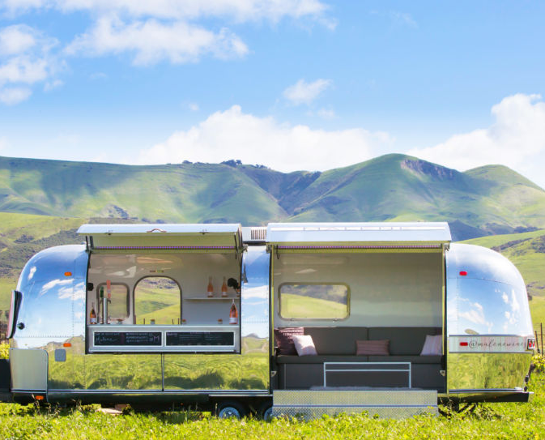
Data we want
(Beautiful & bucolic, harmonic, accessible,
open for business [research, education])

Slide 5
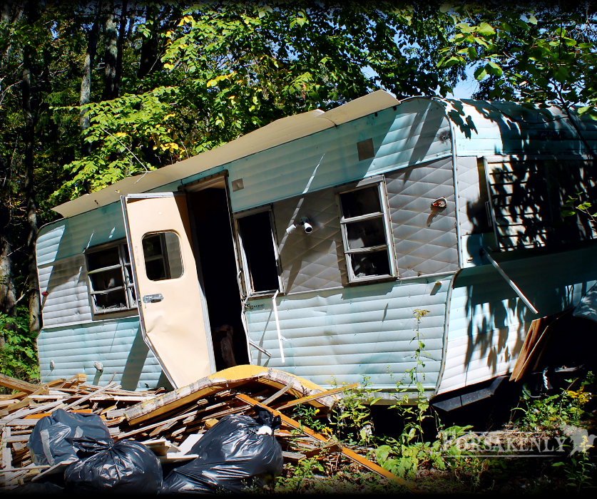
Data we have
(Ugly & unconnected, inaccessible,
unfit)

Slide 6
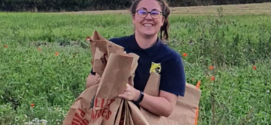
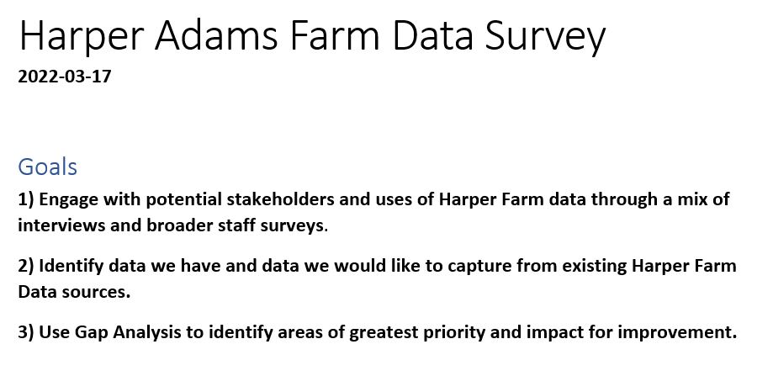
Project: Users of Farm Data Survey outcomes (complete)

Slide 7
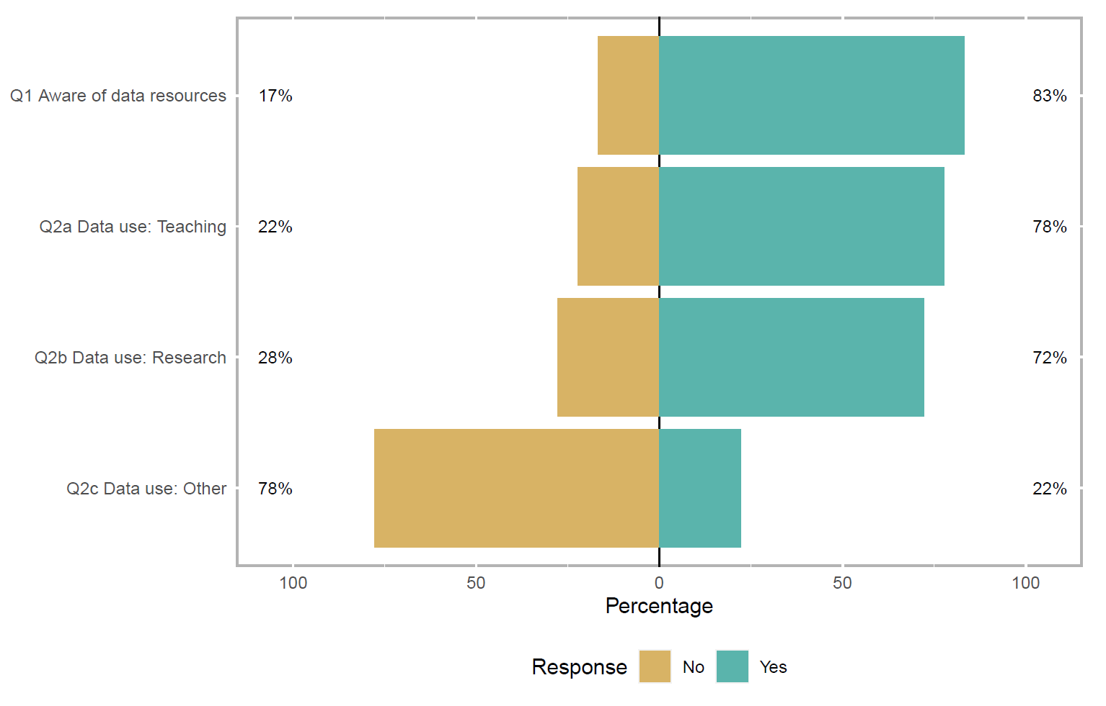
Using data

Slide 8
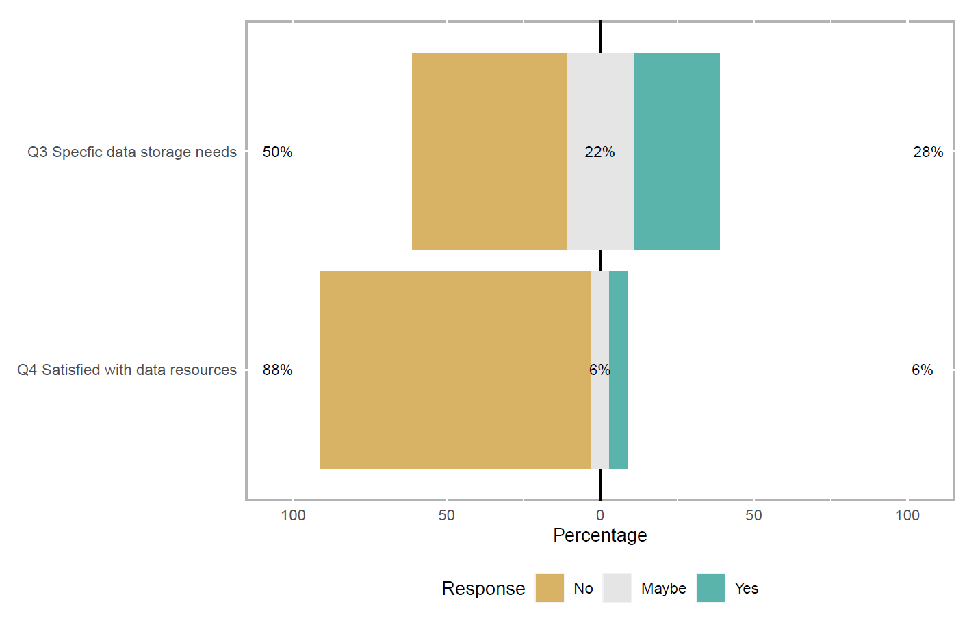
Data access

Slide 9



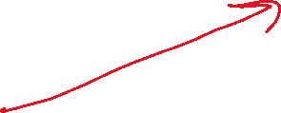

Data access

Slide 10
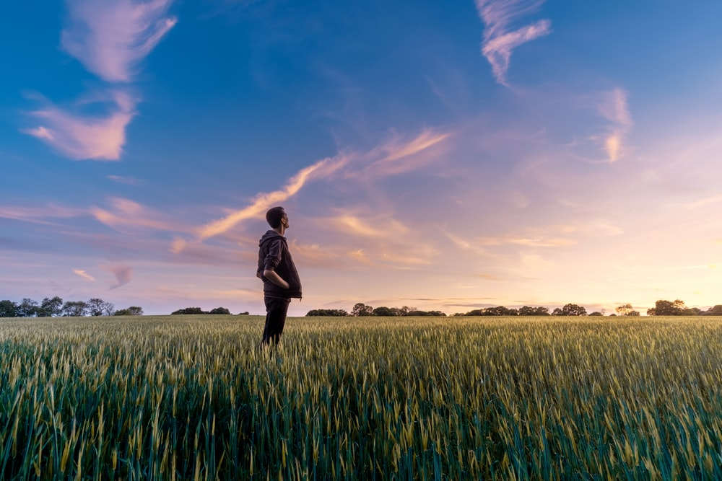
Data
contributions
"...need for carbon footprint data within the harper farm... available data is dispersed"
"...data on calf growth rate, feed intake, temperature for fertility data animals and livestock"
..." Animals and livestock, weather data, milk yields, milk recording, milking order..."
"livestock and arable crops and yield"
"soil organic carbon benchmarking, GIS Data, maps"
Specialized genetic sequence data: "...Biobank, generating samples to go into the bio bank"
weather station data, crop rotation data, field trial data… Some data is confidential, no contingency if I were to leave Harper.

Slide 11
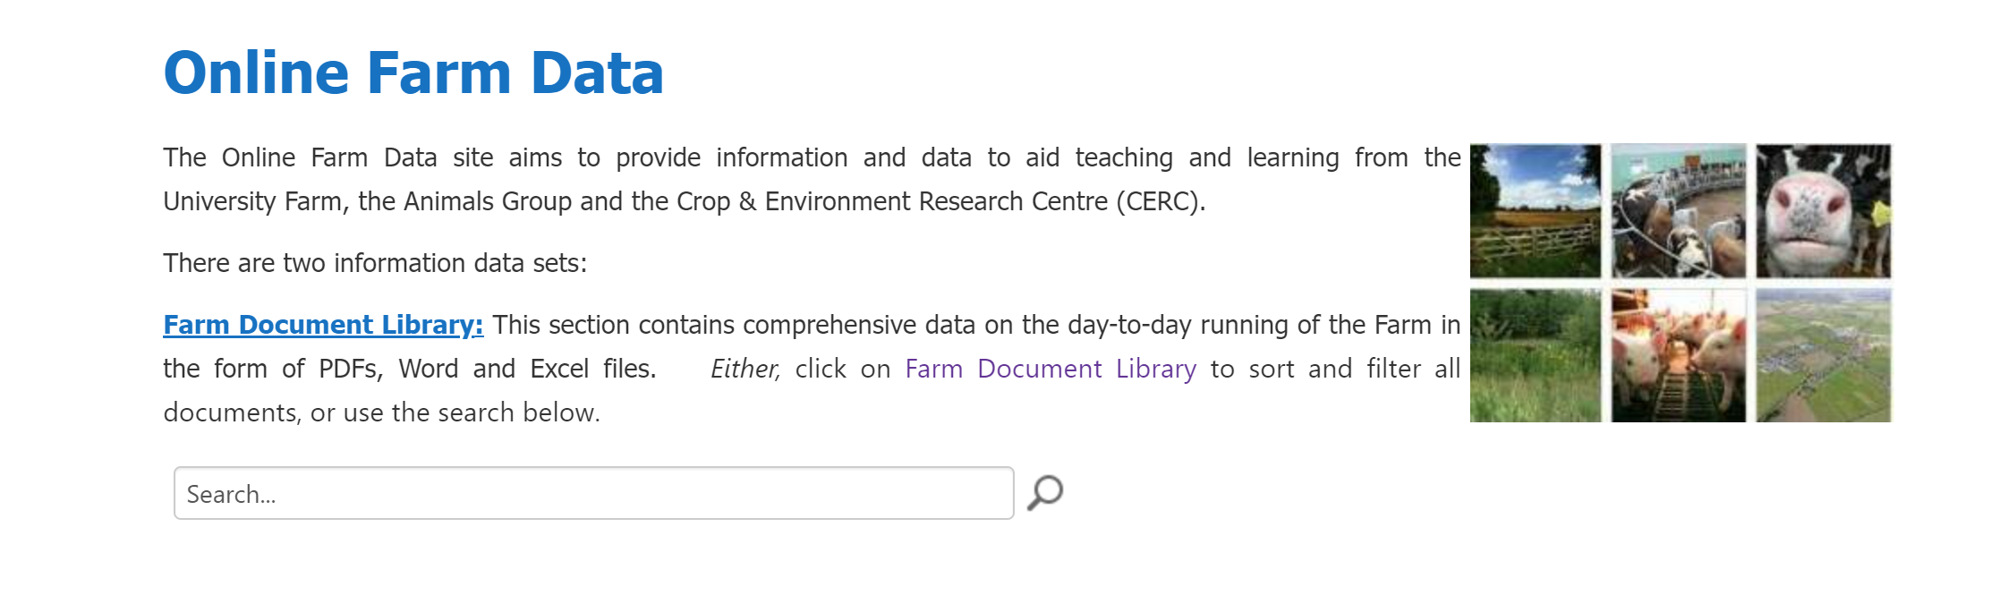
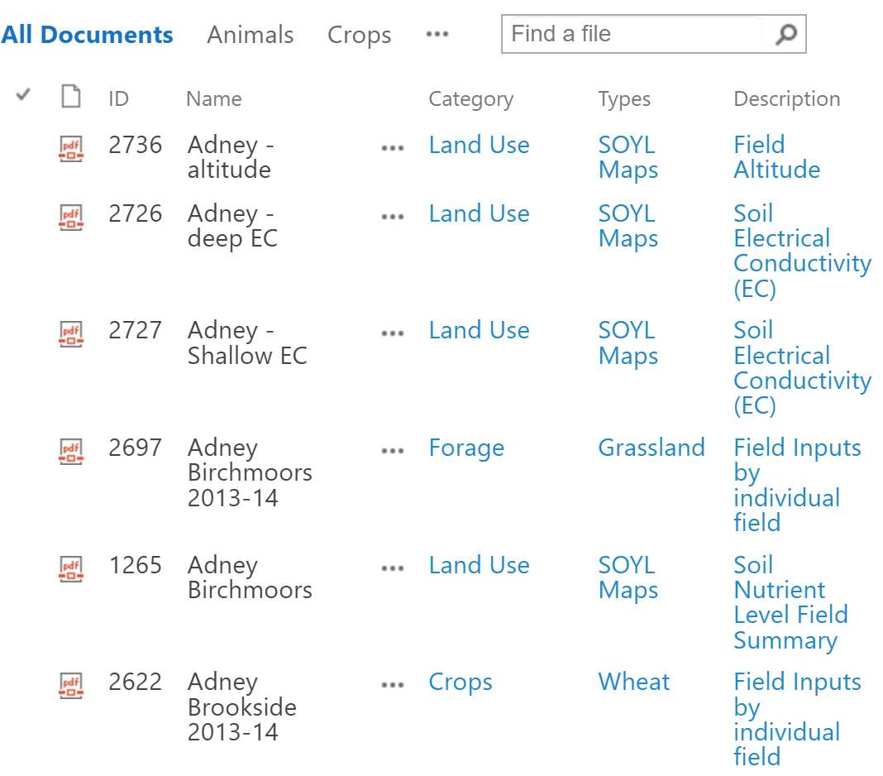
-requires 7 clicks and 2 logins to access list, then 1 login for download
-no metadata, mostly summaries, none of the assets are useful
-you can't actually access it from the link!
https://portal.harper-adams.ac.uk/resources/OnlineFarmData/SitePages/Home.aspx

Slide 12
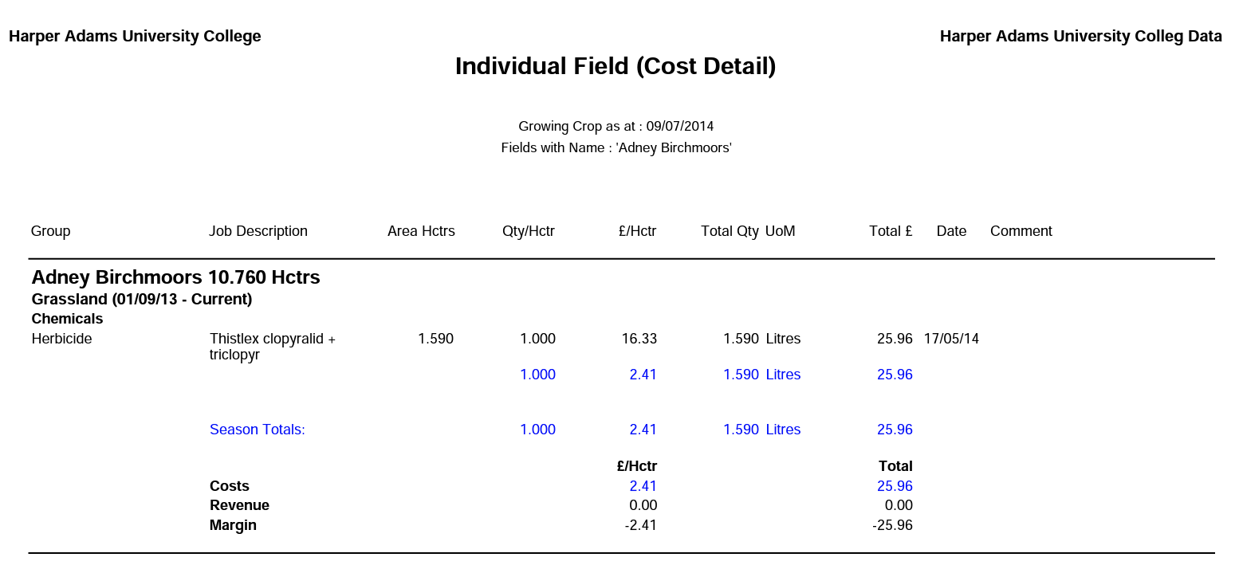
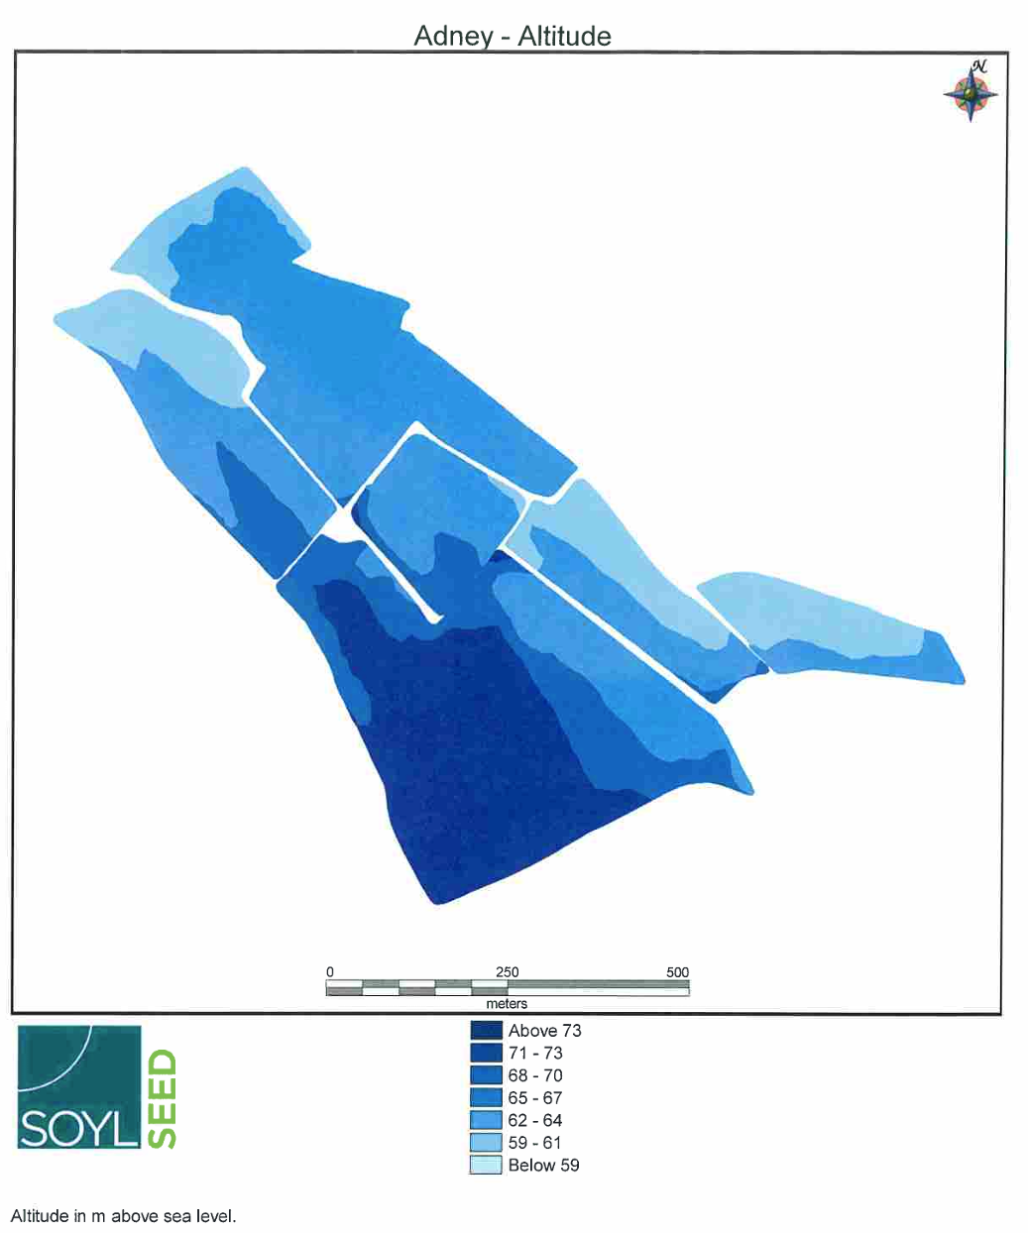
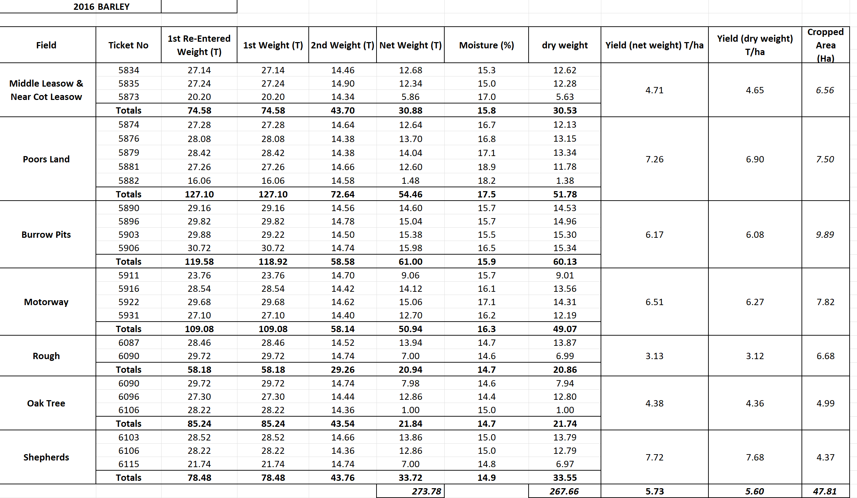
PDF
PDF
Excel
(a few)

Slide 13
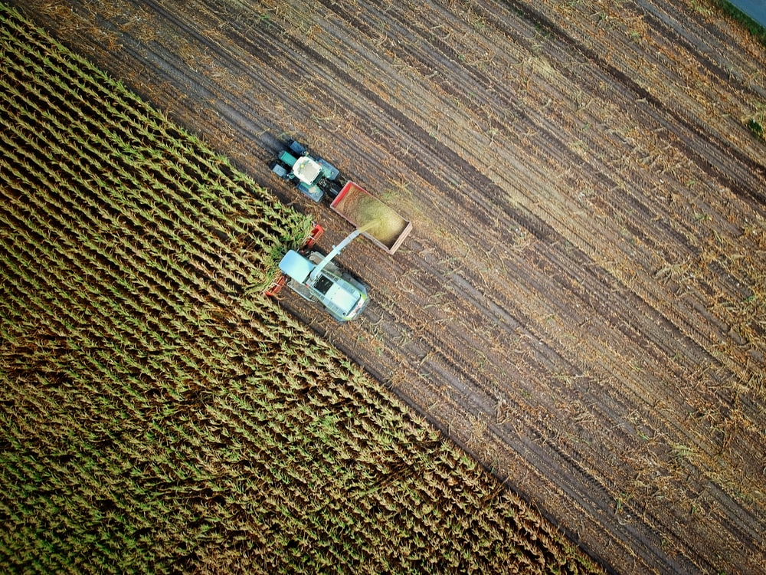
Data
suggestions
"…communication between farm and academics"
"Easy access to farm data"
"Better accessibility"
"maps, knowing what [data] is available, training"
"yields and machinery costings"
"needs to be centralised data management, health records digitalised per animal"
"...robust, centralised data store that is managed"
"field maps"
"[farm] performance data... transparency"
"Someone responsible solely for data curation/management"
"...searchable database, meta data, raw data, meta analysis"
"One programme/software that could do everything ... database "
"farm animal data including health that is accessible..."

Slide 14
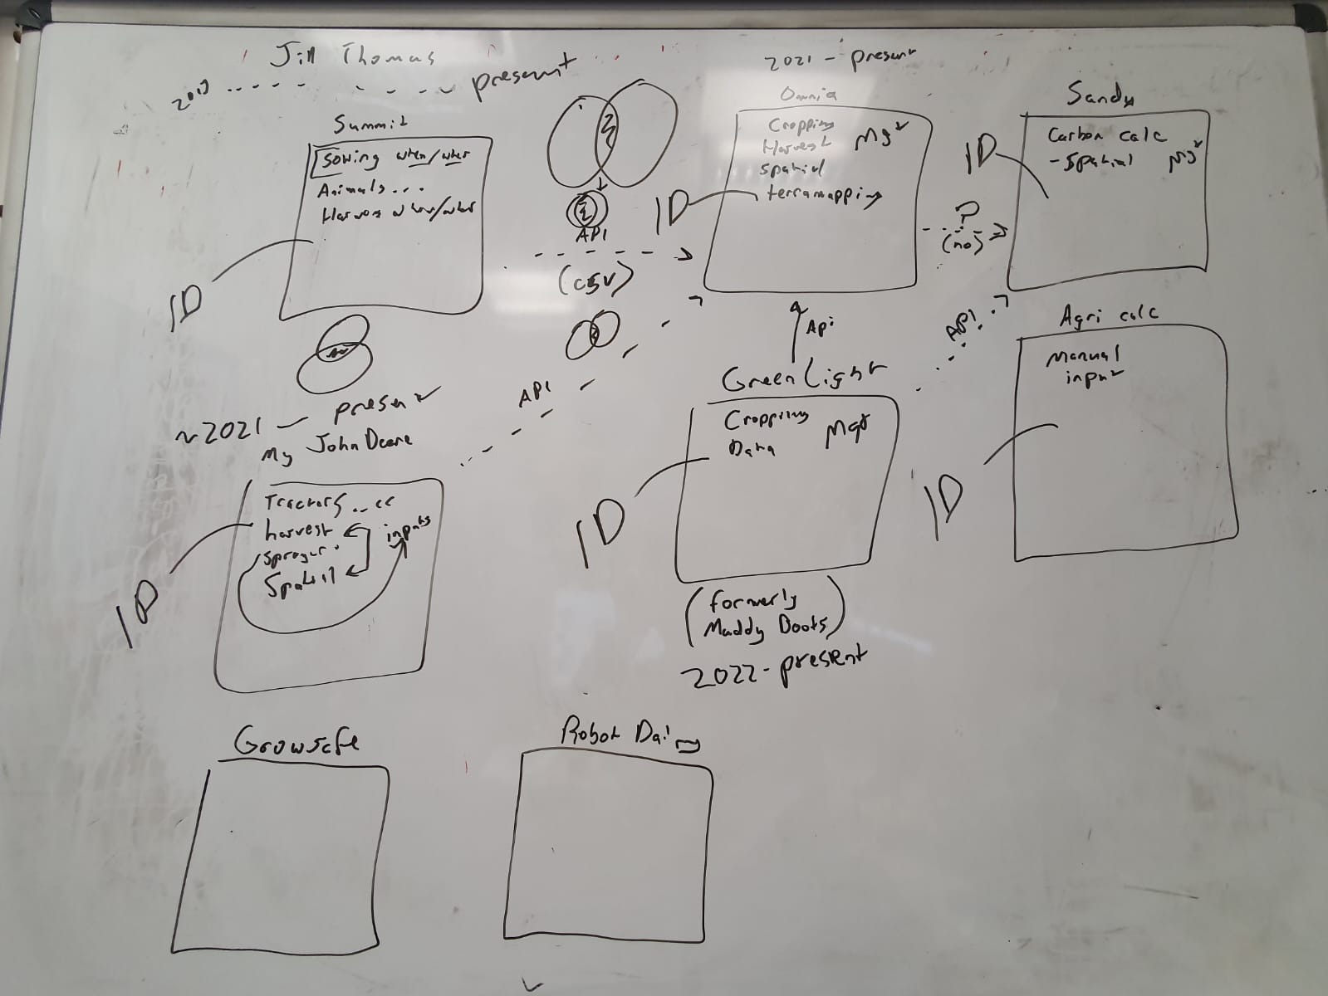
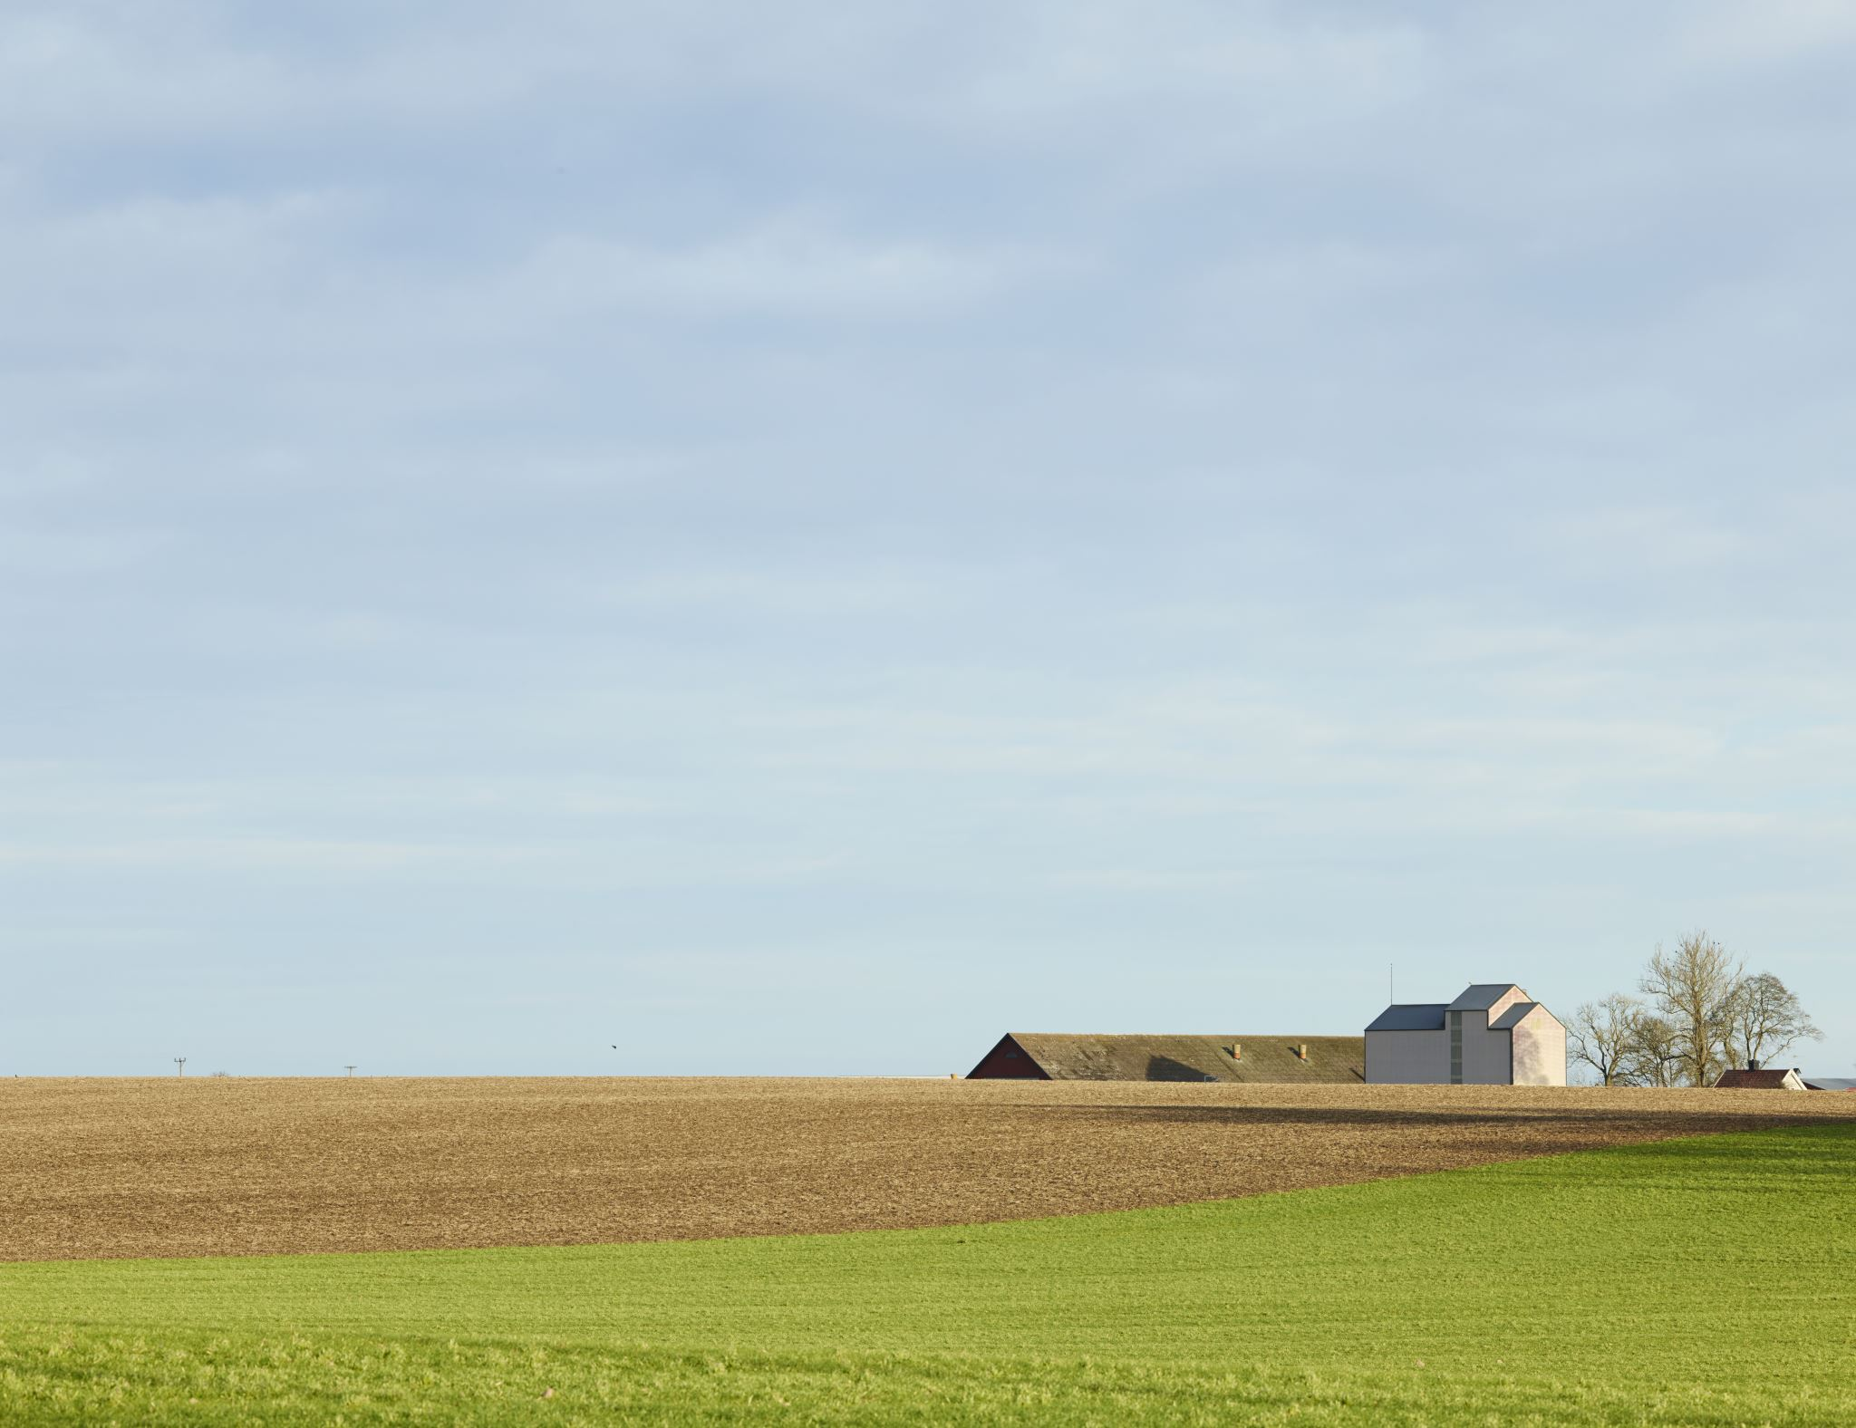
Project: The Harper Farm Database (ongoing)
The farm data are heterogeneous
Different stakeholders have different needs
Farm data systems are… complicated

Slide 15
Specific objectives:
Conduct Farm Data capture best practice exercise for a subset of Farm Data assets based on the previous work conducted by the Data and System Boundaries Group.
To develop a data pipeline for efficient inputs and outputs for the selected Farm Data
Design and develop an example dashboard to find, visualize, and explore data.
Deliver Farm Data workshops to showcase a Farm Data Dashboard and acquire feedback from users as key stakeholders

Slide 16
Elements of best practice
For data generators
-ease of use, low effort
-useful (e.g. decision support)
-consistent (software does not change)
-reliable
For data users
-ease of access (e.g. open)
-useful (e.g. raw data)
-consistent (e.g. same "location")
-user friendly (e.g. browsable)
-metadata and info available
For management
-resilient
-sustainability (cost, admin)
-IP & access management
-exemplary of best practice
(i.e. world leading, innovative)

Slide 17
Software ecosystem
for Farm data
2013-present
2021-present
Summit
Omnia
Sandy
Crop events
Harvest
Field names
Animals…
Crop events
Harvest
Spatial
'Terramapping'
Soil
Carbon calc
Spatial
API (csv*)
maybe
API = the software and data can
"talk and share"
API
API
API
maybe
= redundancy (at least some)
GreenLight
(Muddy Boots)
My John Deere
AgriCalc
Many others
Crop events
Harvest
Management
Carbon calc
Tractors
Harvest (kit)
Spraying (kit)
Spatial
Fuel
Crop events
~2021-present
[earlier?]2022-present

Slide 18
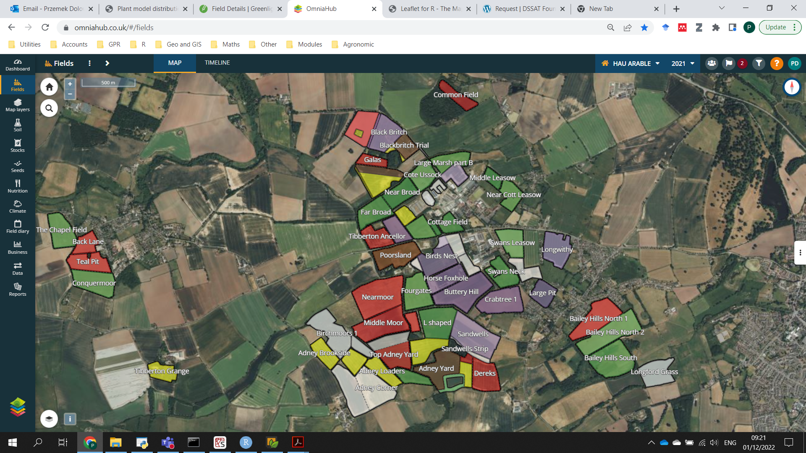

Slide 19
Software ecosystem
for Farm data
2013-present
2021-present
Summit
Omnia
Sandy
Paid ID required
Paid ID required
Paid ID required
Crop events
Harvest
Field names
Animals…
Crop events
Harvest
Spatial
'Terramapping'
Soil
Carbon calc
Spatial
API (csv*)
maybe
API = the software and data can
"talk and share"
API
API
API
maybe
= redundancy (at least some)
GreenLight
(Muddy Boots)
My John Deere
Paid ID required
AgriCalc
Paid ID required
Paid ID required
Many others
Tractors
Harvest (kit)
Spraying (kit)
Spatial
Fuel
Crop events
Crop events
Harvest
Management
Carbon calc
~2021-present
[earlier?]2022-present

Slide 20
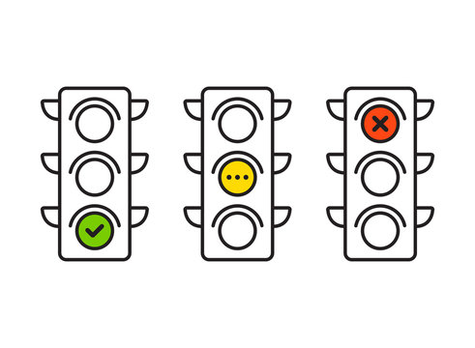
For data generators
-ease of use, low effort
-useful (e.g. decision support)
-consistent (software does not change)
-reliable
For data users
-ease of access (e.g. open)
-useful (e.g. raw data)
-consistent (e.g. same "location")
-user friendly (e.g. browsable)
-metadata and info available
For management
-resilient
-sustainability (cost, admin)
-IP & access management
-exemplary of best practice
(i.e. world leading, innovative)

Slide 21
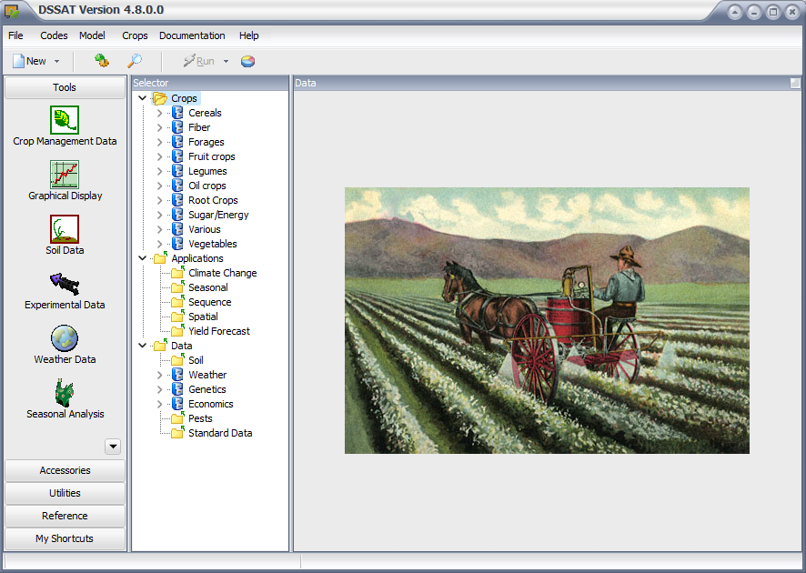
Project: Harper Farm
crop system model (ongoing)
Our overall aim is to create a cutting-edge crop Digital Twin crop systems model, while providing a user-friendly web-based interface as a sandbox for farm decision support, research, and teaching.
Create an evaluate a crop model system tool for Harper Farm that can predict yield and crop phenology under a variety of scenarios including nutrient inputs, alternative nutrients (e.g. manure), soil properties, crop rotation and weather uncertainty
Create and evaluate a simple input and output scenario tool for non-crop modellers

Slide 22
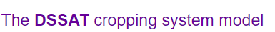
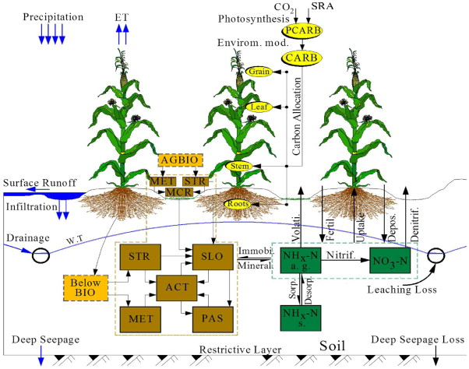
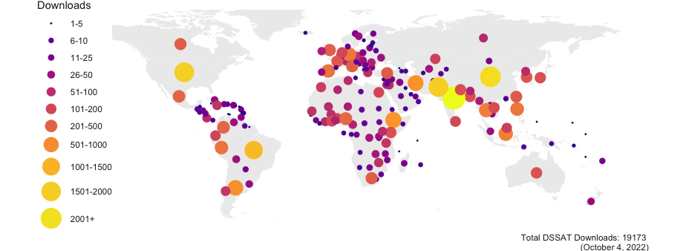

Slide 23
Minimum inputs
-soil
-weather
-spatial (field name, x-y)
-crop & variety
-residue / cover crop
-dates
-seed rates
-inputs (N, P, organics, form, and amount)
-yield

Slide 24
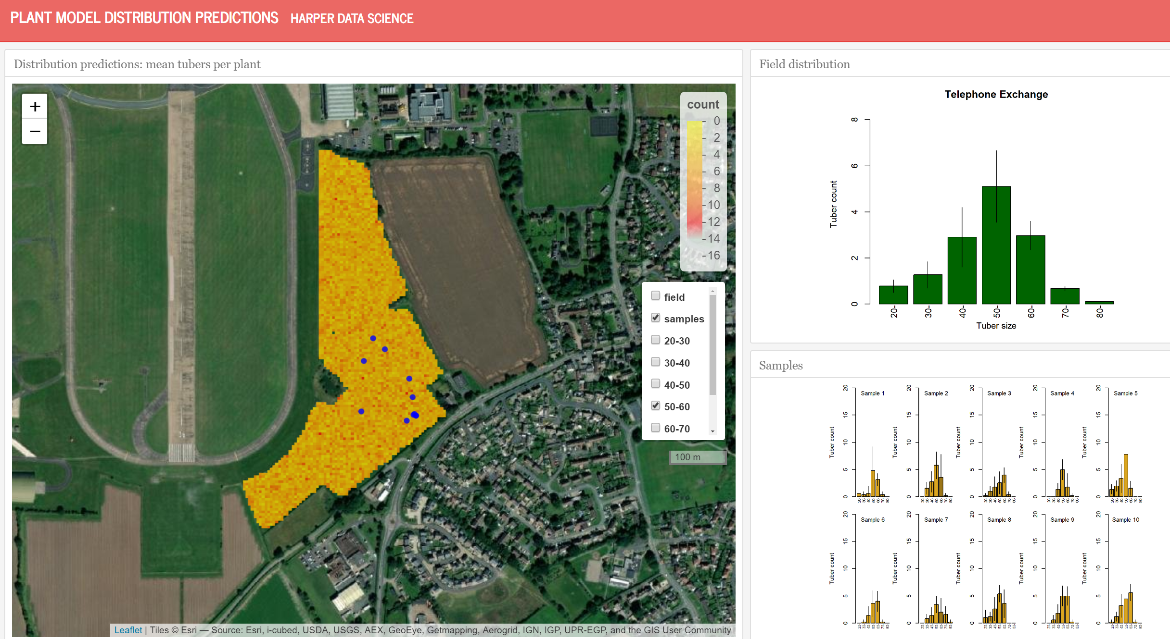

Slide 25
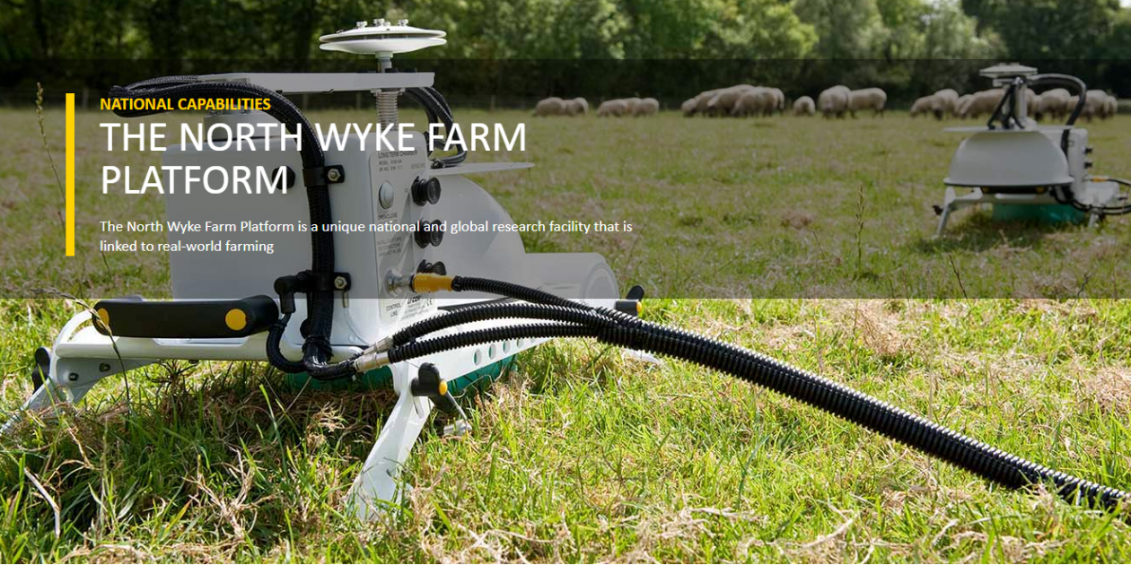
Outreach : Rothamsted Research North Wyke - HAU Future Farm Workshop December 9th 2022

Slide 26
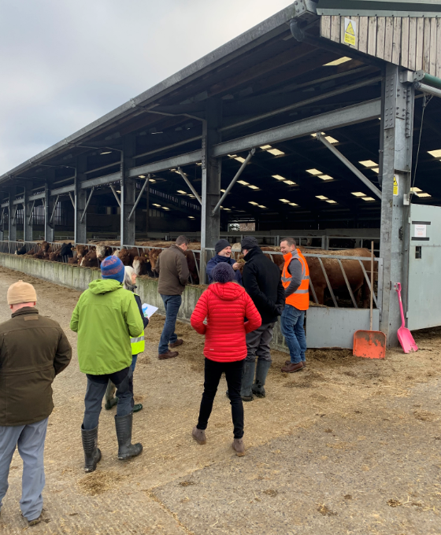
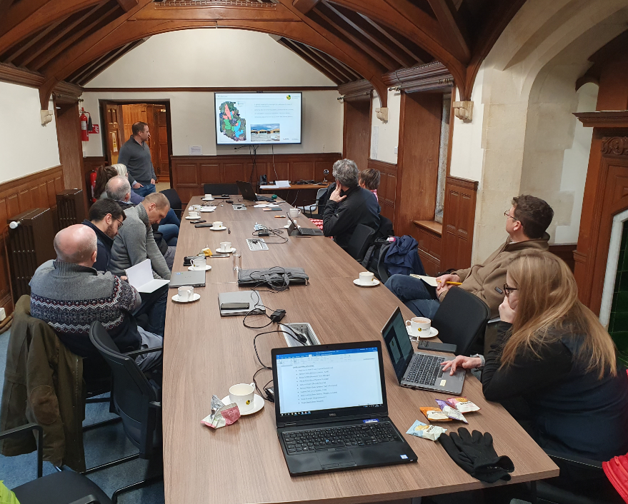
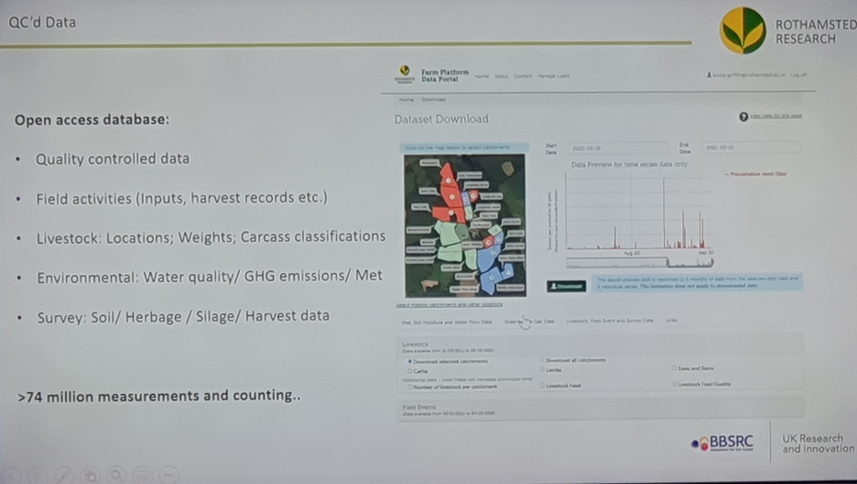
Establish protocols for data collection to achieve efficiency integration with meta-data and core data. Description of data collected
Minimum meta-data to be importing for each experimental/user
Good data management plan
Focus on developing API’s to automate data collection, then QC process etc
Protocols for dealing with sensor drift, ageing and QC data at different scales.
Define open and closed data sets.
Potential to attach DOI’s to data sets

Slide 27
Thank you

Slide 28
Project: Users of Farm Data Survey outcomes (complete)
Project The Harper Farm Database: a platform and dashboard to showcase best practice for all Farm Data stakeholders”
ES/EH - Update on the “Harper Farm Digital Twin crop system model: towards data-informed future farming with DSSAT and Shiny”
KB ? - Mention our planned visit for next week funded by the last competition: “Rothamsted Research & HAU Future Farm Workshop”
GM - Talk about Omnia

